Slide 1

Minimum Spanning Trees
CLRS Chapter 23.1

Slide 2
Minimum Spanning Tree (MST)
A spanning tree is a tree that connects all vertices of graph G.
G=(V,E) undirected, weighted graph.
Weighted graph: all edges have weights.
We would like our Spanning Tree to have the minimum possible total weight.

Slide 3
Minimum Spanning Tree (MST), Example
8
7
4
2
9
11
14
4
10
8
7
6
1
2

Slide 4
Minimum Spanning Tree (MST), Example
8
7
4
2
9
11
14
4
10
8
7
6
1
2

Slide 5
Minimum Spanning Tree (MST), Example
8
7
4
2
9
11
14
4
10
8
7
6
1
2
8
7
4
2
9
11
14
4
10
8
7
6
1
2

Slide 6
Generic MST algorithm:
Pick edges one by one, collect in a set named A
Invariant: A should always be subset of some MST
MST always has n-1 edges (why?)
Once A has n-1 edges, given the invariant, A must be MST
There can be many MSTs.
Big question: how to maintain the loop invariant?

Slide 7
Generic MST algorithm:
Big question: how to maintain the loop invariant with every edge we pick?
The edge we pick must be a “safe” edge.
(it must be the lowest weight edge that connects two previously unconnected parts of G)
There are multiple “safe” edges.
Depending on how you pick your safe edges, you have a different algorithm.
We will see Prim’s.

Slide 8
Example of a safe edge
8
7
4
9
2
11
14
4
10
8
7
6
1
2

Slide 9
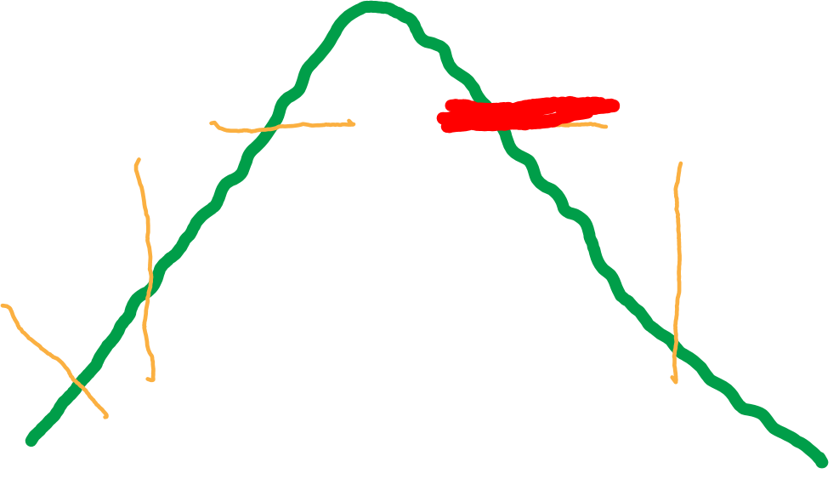
Example of a safe edge
8
7
4
9
2
11
14
4
10
8
7
6
1
2

Slide 10
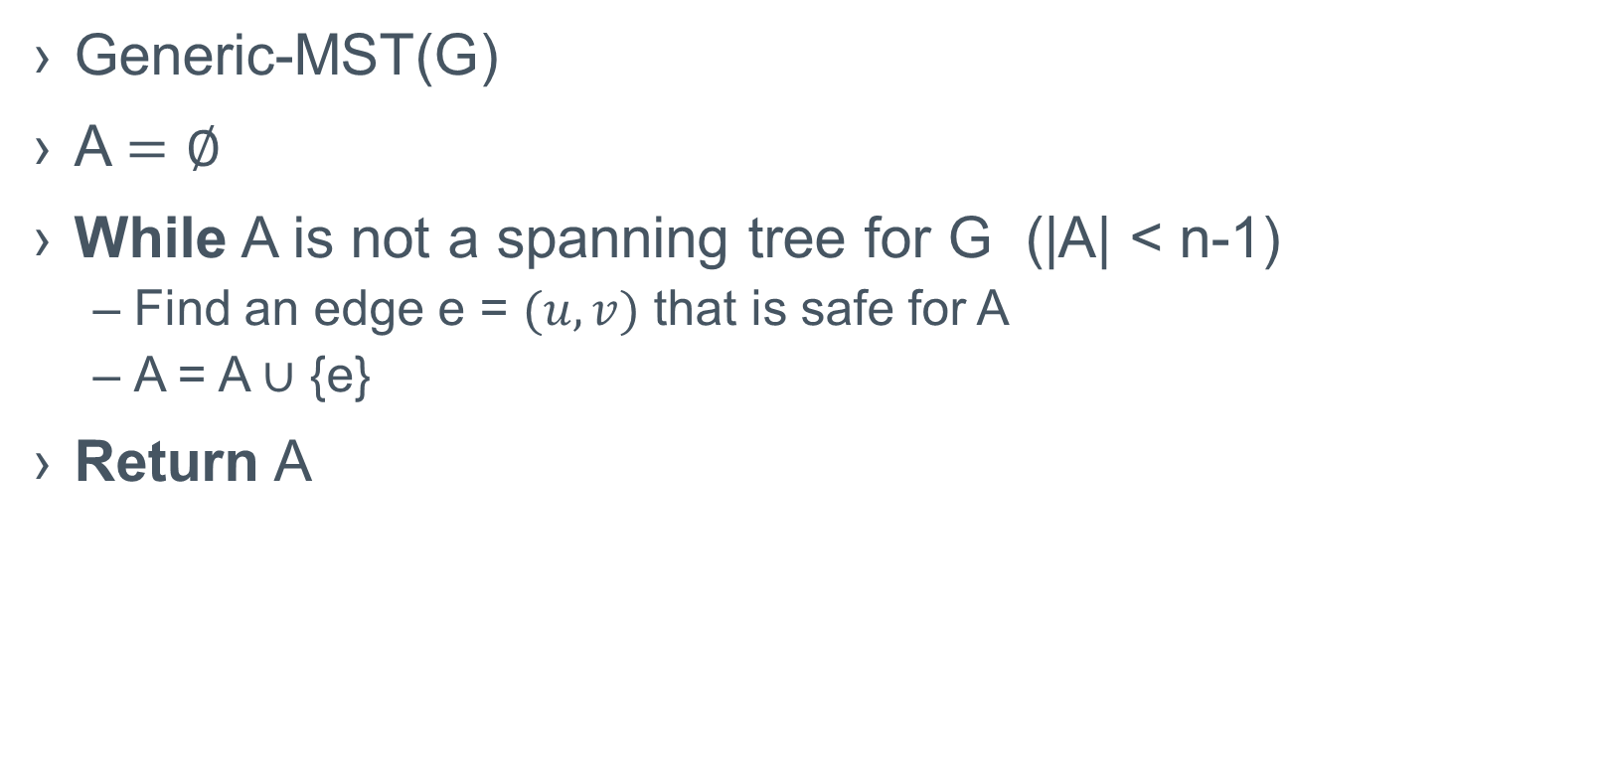
Generic MST algorithm
Generic-MST(G)
A $=∅$
While A is not a spanning tree for G (|A| < n-1)
Find an edge e = $(u,v)$ that is safe for A
A = A $∪$ {e}
Return A

